Slide 1
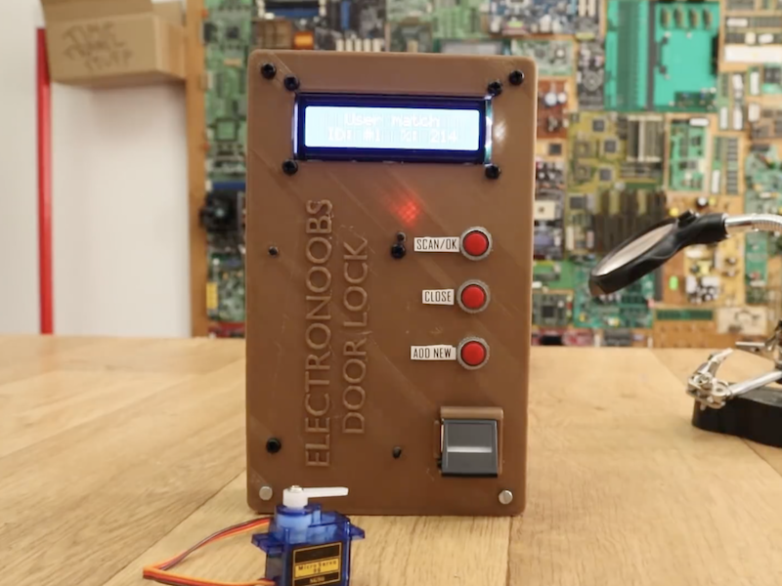
SMART DOOR LOCK USING FINGERPRINT
Project id:23_Cs_iot_3A_13

Slide 2
ABSTRACT
According to ancient Greek scripts BIOMETRICS means study of life. Biometrics studies commonly include fingerprint, face, iris, voice, signature, and hand geometry recognition and verification. Many various stages of other modalities are in various development and assessment. Among these available biometric traits, fingerprint proves to be one of the best traits providing good mismatch ratio and also reliable.

Slide 3
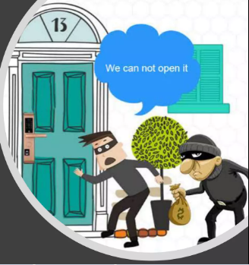
Smart Lock’s Main Functionality
Smart lock systems use Bluetooth and WiFi ,solutions to open or close the door. You can use Bluetooth when you are close to your lock . But via the WiFi, you can open the door from anywhere.
Particularly, most producers have key fobs connected to the lock that gives access to a physical object.
A key fob is a small security hardware device with built- in authentication.
It is used to control and secure access to computer systems, network services, and data.
Smart lock systems provide mobile apps and websites for sending virtual keys. Moreover, you can grant access to your friends and relatives by sending SMS or email.

Slide 4

BENEFITS OF FINGERPRINT DOOR LOCKS
Maximum control over who enters your home
Unmatched security
The door automatically locks when it gets shut
You cannot tamper with these door locks
They look great and set off a great first impression

Slide 5
HOW SMART LOCK WORKS?
The smart lock gives an opportunity to get rid of the house key by using your smartphone to lock and unlock the door.
For this reason, this technology uses wireless protocol and a cryptographic key to send signals from the device.
It means, you can give access to the third party even if you are not in the city. But this is not the only function.
In addition, smart locks can monitor access and send alerts in critical situations.

Slide 6
Software And Hardware Tools
Minimum Hardware Requirements
Fingerprint Scanner
GSM Module
Camera
Servo Motor
Adapter
12 v solenoid lock
Arduino UNO
Jumper Wires
Minimum Software Requirements
Windows 7
Blynk
Python
Visual Studio Code

Slide 7
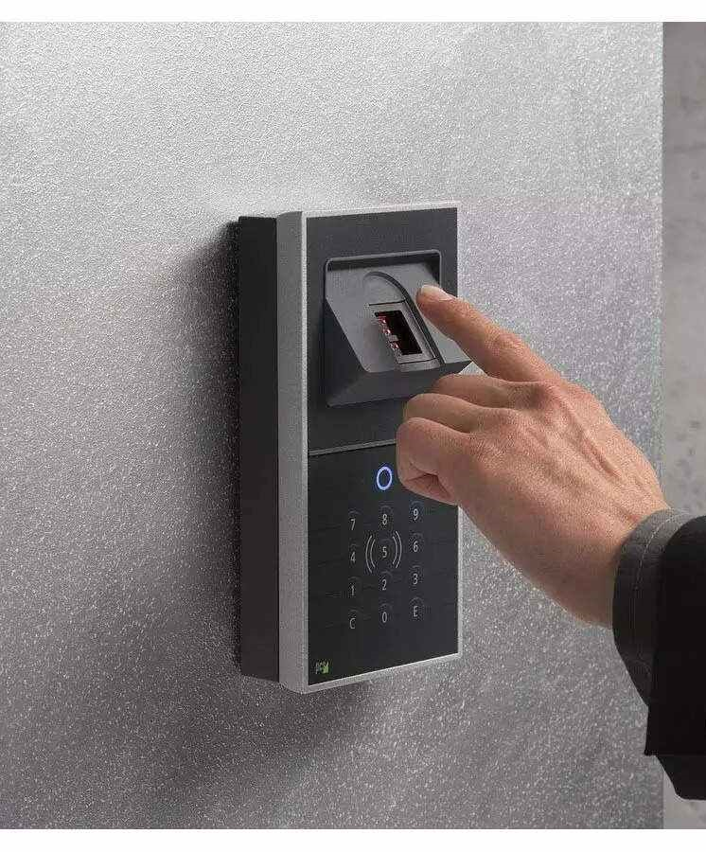
SMART LOCK SECURITY
By now, you should be worried about smart lock security. Let's understand how current smart lock security works.
Those messages that are sent from the lock to the cloud via the smartphone and back are encrypted.
Bluetooth Channel may also offer security features. HTTPS protects the privacy and integrity of the exchanged data.
The key is only shared between the cloud server and the chip. However, it is clear that only encryption is not enough to provide security.
Indeed, a hacker can catch the message sent from the cloud to the lock, save it, and use it later. Now, it is obvious that smart lock security issues are the main reason why smart lock doesn't work.

Slide 8
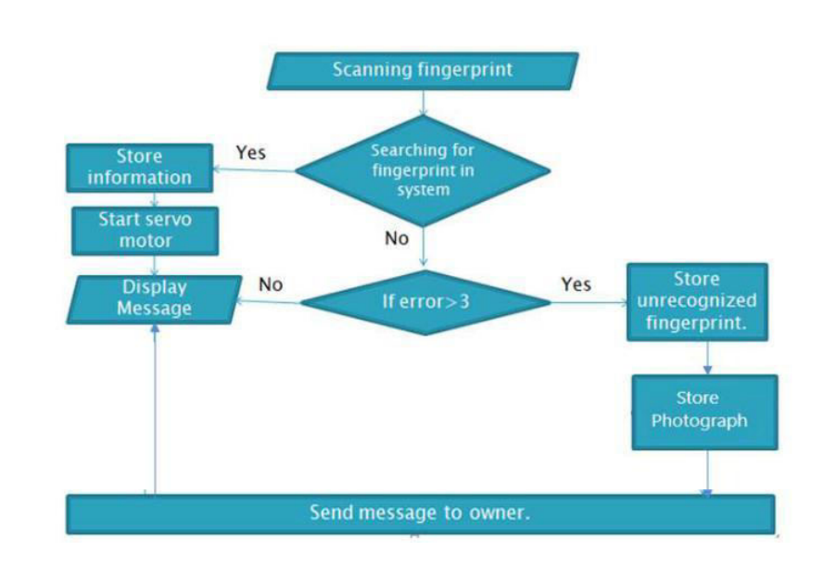
Smart lock Access Control System
Smart Lock Access Control System . It consists of the following elements:
。 lock controller
。 smartphone
o cloud
The smartphone works as the mediator between the lock and the cloud:
it receives an encrypted message from the lock and forwards it to the cloud server, and vice versa.
The cloud server authorizes the smartphone
and gives the lock a command to open if the
user has access rights.

Slide 9
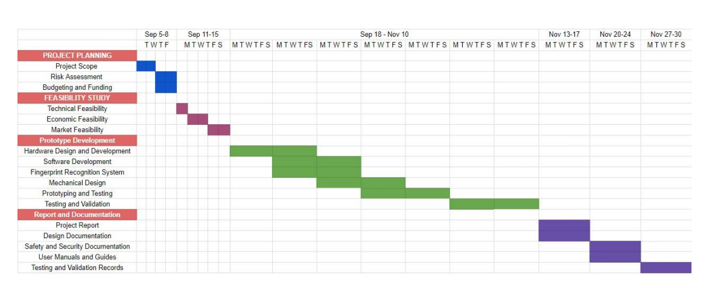
Feasibility Study

Slide 10
Feasibility Study
1. Technical Feasibility: The necessary technology, including fingerprint sensors, microcontrollers, and communication modules, is readily available and affordable. The project team possesses the requisite technical skills and expertise for successful development.
2. Market Feasibility: Market research indicates a growing demand for smart door locks with biometric authentication features. The target audience, primarily homeowners and businesses, shows interest in adopting such advanced security solutions. Preliminary cost estimates align with expected market pricing and revenue potential.
3. Legal and Regulatory Feasibility: There are no existing patents or legal restrictions that hinder the development of a fingerprintbased door lock. The project will comply with data privacy laws and security standards, ensuring user data protection.
4. Operational Feasibility: The project team has access to the necessary resources, including lab facilities, development kits, and software tools. A well-defined project timeline with key milestones and deadlines has been established. Potential risks and challenges have been identified, and mitigation strategies are in place.
5. Economic Feasibility: A comprehensive cost-benefit analysis suggests that the project's benefits, including potential revenue and cost savings, outweigh development and production costs. A positive return on investment (ROI) is expected, making the project financially viable.

Slide 11
Smart Door lock …
ADVANTAGES
DISADVANTAGE
It can only be opened when an authorized user is present, so password or pin is not remembering it.
most secure and accurate than traditional password
Password based security system has always the threat of being stolen and accessed by the unauthorized user, but here It can only be opened when an authorized user is present.
It’s very costly.

Slide 12
CONCLUSION
Hence in this project we developed an access control system using fingerprint print technology and demonstrated the use of biometrics and embedded systems to improve security
The intrusion alert enhances the security of the system. The prototype-built shows that the design consumes minimal power, and the locking/unlocking of the door happens in 4 seconds on an average.

Slide 13
REFERENCES
1. Anil K. Jain, Arun Ross and Salil Prabhakar. An Introduction to Biometric Recognition. IEEE Transactions on Circuits and Systems for Video Technology, Special Issue on Image and Video Based Biometrics, Vol. 14(1), January, 2004.
2. “(PDF) Password Based Door Lock System Using Arduino,” Research Gate. https://www.researchgate.net/publication/330998913_Password_Based_Door_Lock_System_ Using_Arduino (accessed Aug. 08, 2021).
3. Meenakshi, N, M Monish, K J Dikshit, and S Bharath. “Arduino Based Smart Fingerprint Authentication System.” In 2019 1st International Conference on Innovations in Information and Communication Technology (ICIICT), 1–7. CHENNAI, India: IEEE, 2019

Slide 14
THANK YOU!
ANY queries??

